Slide 1
BI &
ANALYTICS

Slide 2
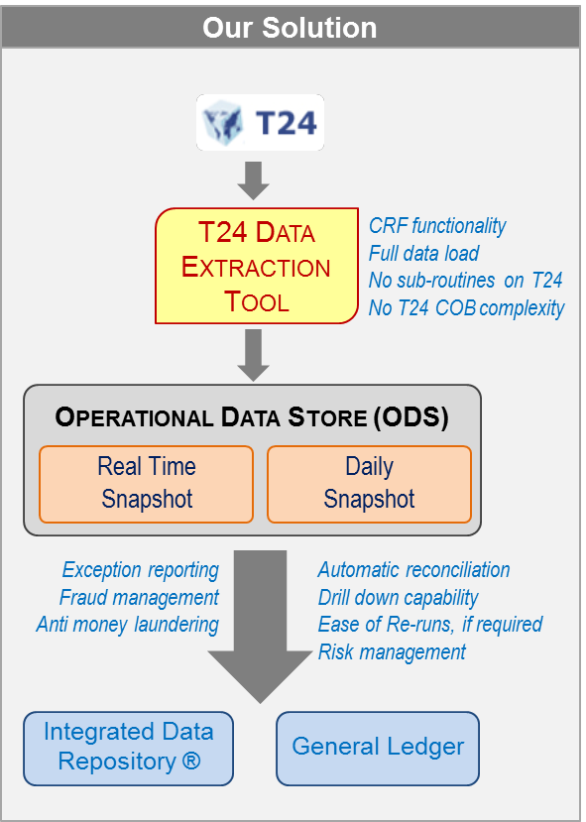
Case study : Large Asian Bank
Situation
Leading bank in a country in Asia-Pacific (~ 2 million customers, 400+ branches)
Faced significant issues post-cutover to new core banking system, T24, resulting in regulatory, customer, MIS/reporting & operational challenges
Bank GL delivered only on Day 3
Regulatory returns delayed & a high risk of misreporting
Financial risk due to weakened reconciliations & controls, regulatory fines, etc.
Data environment adversely impacted due to issues in extraction of data from T24
Scalability issues as the Bank continued on its ambitious growth path
Solution delivered
Comprehensive enterprise-wide Post-Implementation Review of Bank’s T24 environment
Identification & resolution of accounting configurational (technical & functional) gaps in T24
Identification & resolution of gaps in Bank’s GL processes
Identification of issues in T24 code and escalation to Temenos
Bank achieved timely production of Bank GL by 6am, T+1
Developed enterprise-wide data environment for all management information & reporting requirements
Provided T24 & related training to staff in Finance, IT, Business Intelligence & other departments

Slide 3
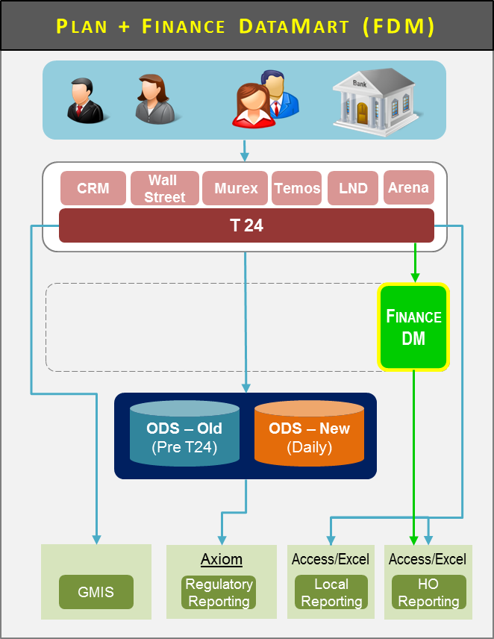
CLIENT : Leading global bank
Situation
Leading global private bank’s Asian head office in Singapore
Bank launched implementation of T24 Core Banking System, commencing with Asia. T24 to interface with over 70 other systems in the Bank (35+ global, 35+ local)
Bank, working with the implementation partner & vendor, unable to resolve 13 major Finance gaps. Further, it was possible that gaps identified in other T24 modules may also impact Finance. Need to establish way forward to align GAAP requirements in Bank’s global Head Office & in Asia
Tight project timeline & is seeking to identify solutions to Finance gaps in coming weeks
Ensure that any solution should leverage on Bank’s current & ongoing investments in technology tools & platforms and serve as a bridge to Bank’s planned implementation of SAP.
Solution delivered
Comprehensive review & established recommended solutions to address all Finance gaps, including providing indicative estimates for effort required
Reviewed gaps impacting T24 implementation, in context of Technical & Functional architecture
Active interactions with Finance, Risk, IT, Product Control, System Build & Integration team, Global Risk, Global Finance, Operations, Temenos, etc. to ensure our solutions were comprehensive and met needs of all stakeholders
Mapped vis-a-vis leading practices to identify & assess gaps and prioritise actions
Designed Finance DataMart (FDM) environment to address gaps to meet Head Office reporting requirements
Developed a roadmap including quick wins, short to medium-term remedial initiatives, and identified strategic decisions required to achieve a successful T24 implementation

Slide 4
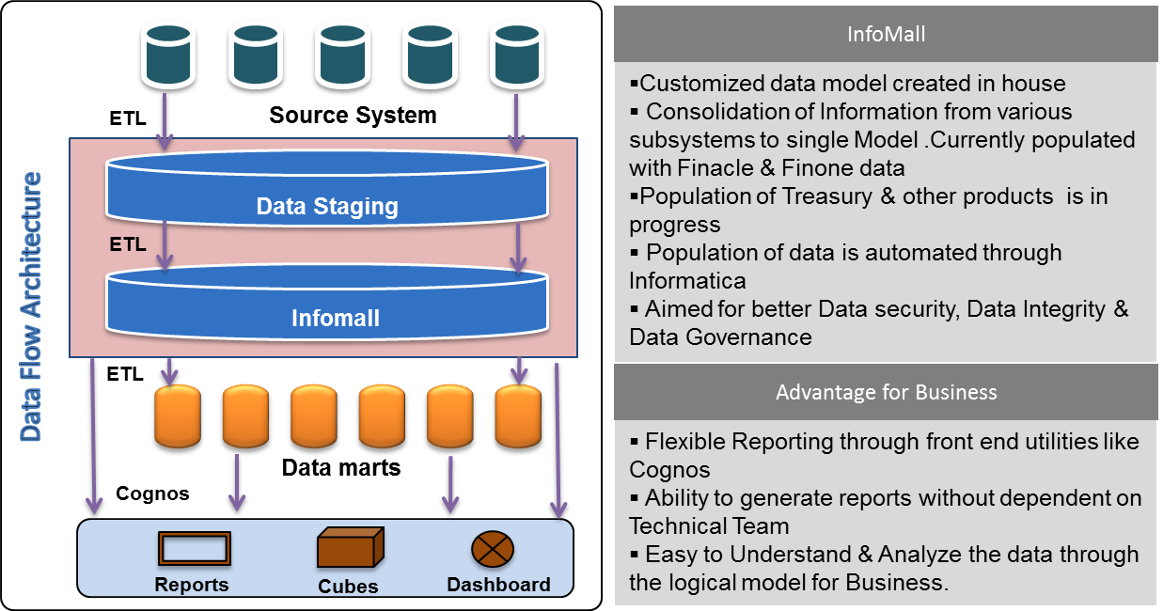
CLIENT : large GCC bank
Situation
Data in disparate systems and absolutely no ownership for data. Reports generated were never accepted by business (lack of trust)
Multiple representations of customer in different systems
Reconciliation posed a challenge to the Bank
No consolidations standards existed, data governance, or data management on parent-child relationships, linkages for metadata
Solution delivered
Developed & deployed Technical Interface for Bank Applications. Standard ETL Tool (Informatica) usage across all applications
Reduced workload on Applications & Middleware, Implementation at a reduced cost, and end-to-end automation of process
InfoMall repository in place; development & production environments separated; data marts (including entity data) are separated from staging. New servers deployed
Turnaround time reduced by 50%; Daily MIS available from 8.30 a.m.
5 years of history available. Data compliance met with role-based access
Created reports & dashboards to assist performance and movement analysis, risk monitoring, transactions & turnover
Time-sheet system institutionalized;
Robust Project management practices implemented.
Status, cost and effort reports on weekly basis

Slide 5
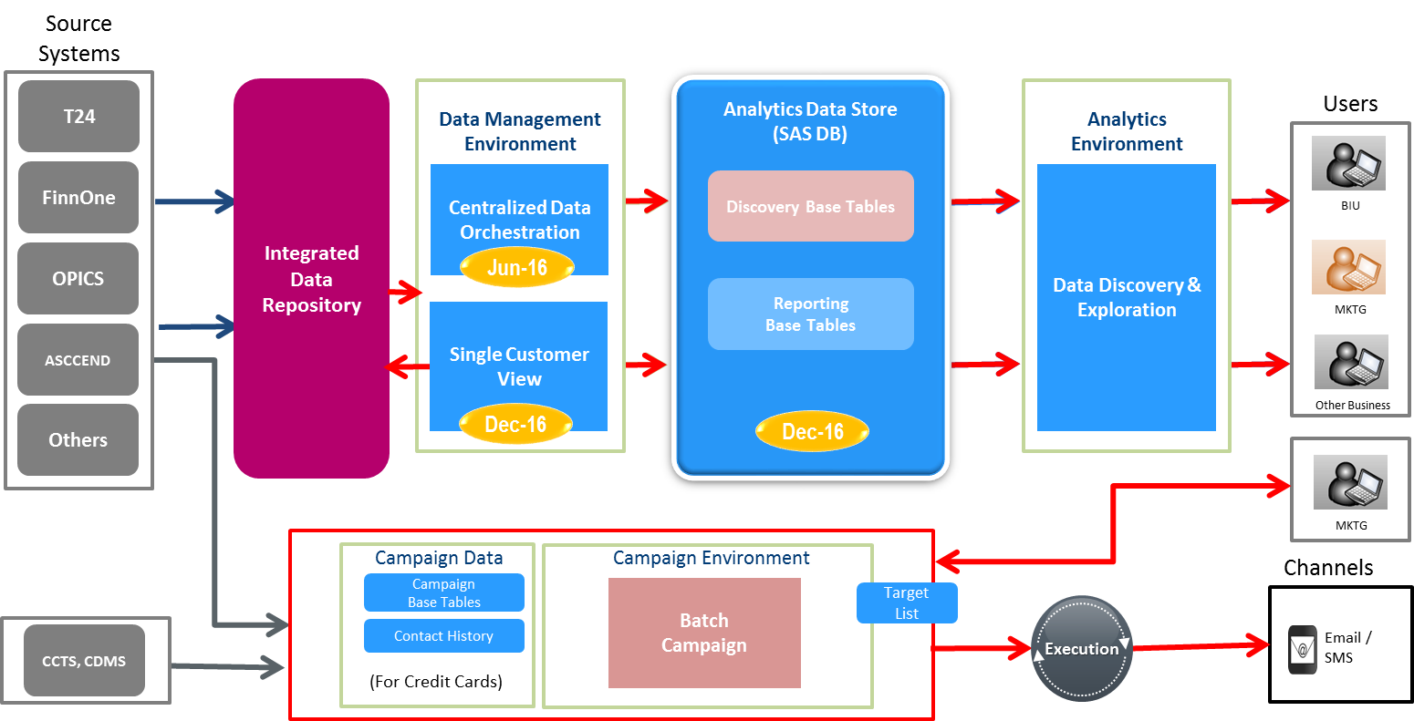
CLIENT : Leading Asian bank
Situation
Bank using SAS for Campaign management & Finance reporting
Data was maintained in SAS-specific data files on standalone PCs with weak infrastructure and risk of data security breach/loss
Licensed SAS components were limited to data integration using scripts (Base SAS)
Core statistical components for data mining & advanced analytics were not available
SAS Event Based Marketing (EBM) implementation was under-utilized (only 2 campaigns conducted in 2 years)
Solution delivered
Guided Business Intelligence Unit (BCC) & SAS to refine and develop a new end-state architecture
Assisted Bank negotiate with vendor for SAS Enterprise licensing and delivery of proof of concept for centralized SAS reporting
Enabled data mappings from Integrated Data Repository (IDR) to SAS reporting
Developed a road-map to move towards SAS data integration, Visual Analytics and Microsoft Dynamics for Single Customer view
Assisted bank formulate loop-back mechanisms into IDR for efficient performance analysis and effectiveness of campaigns.

Slide 6
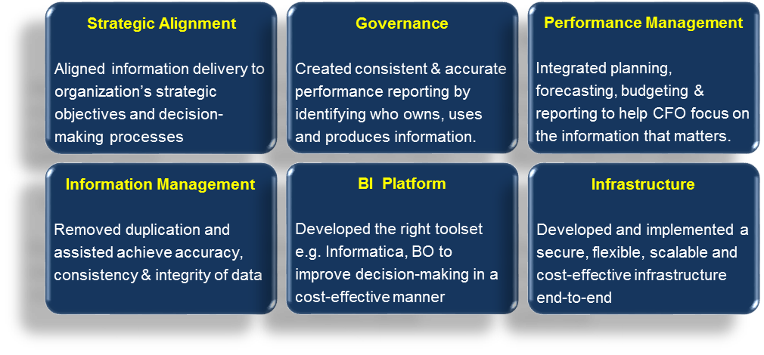
CLIENT : large GCC bank
Situation
Minimal expertise in Business Intelligence & data warehousing
Regulators demanding granularity, flexibility and speed.
Internal business users demanding varied reporting for innovating products for customers
Lack of standardized data and alignment with Finance, Risk and business functions
Multiple bespoke solutions in IT servicing posed reconciliation challenges.
Solution delivered
Enhanced project functioning within the bank & delivered value to all stakeholders.
Guided Bank for consistent delivery of BI projects, while allowing flexibility to address individual project challenges
Helped Bank develop a BICC – a central pool of BI project managers, data modellers, architects and business analysts.
Enabled bank in developing a new culture around BI, and adopt leading practices

Slide 7
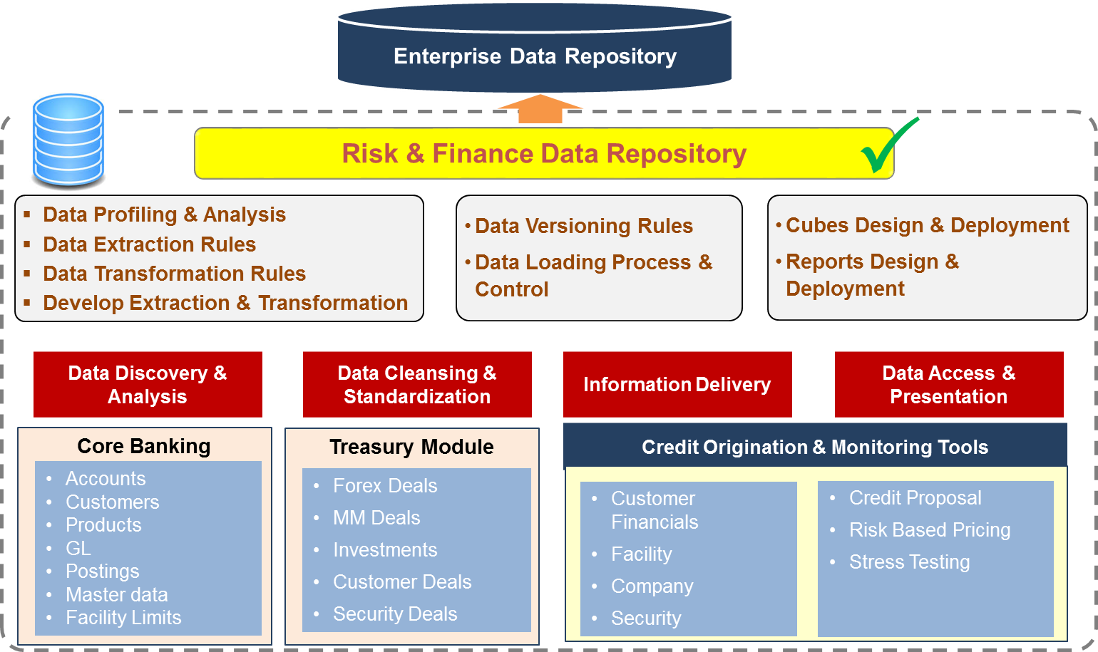
CLIENT : African bank
Situation
Refine and enhance end-to-end credit processes including:
Credit risk policies and procedures, and Credit risk governance
Improve data quality, policies & procedures
Credit risk monitoring methodology and process documents, including dashboards
Strengthen collateral management
Pricing methodology for credit risk, including how risk is incorporated into the pricing
Implement a credit risk data model and repository, including validating data quality
Enhancement, development and implementation of credit, operational and market risk dashboards
Solution delivered
Delivered a number of solutions, tools, templates, policies & process designs
Established Enterprise Risk Data capability
Recommended way forward for risk governance, processes, data, ALCO processes, and market risk management
Project reports on each work-stream detail progress made and the transformation roadmap to achieve Bank’s ERM vision.

Slide 8
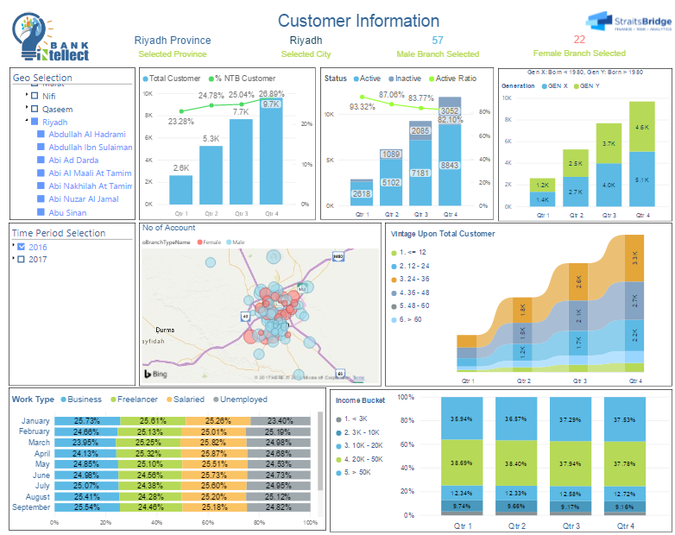
Case Study : LARGE ISLAMIC BANK
Situation
According to a survey more than 66% banks have absence of adequate tools to monitor followings:
Branch performance in a timely manner
Loss of business due to delay or lack of information about customer activity
Loss of revenue due to excessive fee or profit waiver to customers not properly tracked.
Inefficiency in process leading to wastage and therefore cost going un-noticed.
Inadequate management information.
Solution delivered
Designed and developed a BRANCH MANAGERS DASHBOARD covering the following information areas.
Customer Base Analysis
Sales information
Assets and Liabilities Portfolio
Productivity
Exceptions Analysis

Slide 9
Confidentiality
Our clients’ industries are extremely competitive. The confidentiality of companies’ plans and data is obviously critical. StraitsBridge Advisors will protect the confidentiality of all such client information.
Similarly, advisory, consulting and training is a competitive business. We view our approaches and insights as proprietary and therefore look to our clients to protect StraitsBridge Advisors’ interests in our proposals, presentations, methodologies and analytical techniques. Under no circumstances should this material be shared with any third party without the written consent of StraitsBridge Advisors.
Copyright
Copyright © 2018 StraitsBridge Advisors Pte Ltd. All rights reserved.
No part of this work may be reproduced or transmitted in any form by any means, electronic or mechanical, including photocopying and recording, or by any information storage or retrieval system, except as may be permitted, in writing, by StraitsBridge Advisors Pte Ltd.
All trademarks, service marks, trade names, product names and logos appearing in this document are the property of their respective owners, including in some instances StraitsBridge Advisors. Any rights not expressly granted herein are reserved.
StraitsBridge Advisors Pte Ltd
20 Collyer Quay
#10-06
Singapore 049319
Tel. +65 6909 2920
StraitsBridge Advisors
P.O. Box 454671
Dubai
United Arab Emirates
Tel. +971 50 841 5123
Your daily source of top global news
Go to news.straitsbridge.com for free subscription
www.straitsbridge.com
info@straitsbridge.com

